Slide 1
Wisconsin Statewide
Value-Added Training
CESA TRAINING #1
April 12, 2012

Slide 2
Value-added context
Value-Added Research Center Projects
The Goal of Value-Added in Education
Using Value-Added with Other Data
Sean McLaughlin

Slide 3
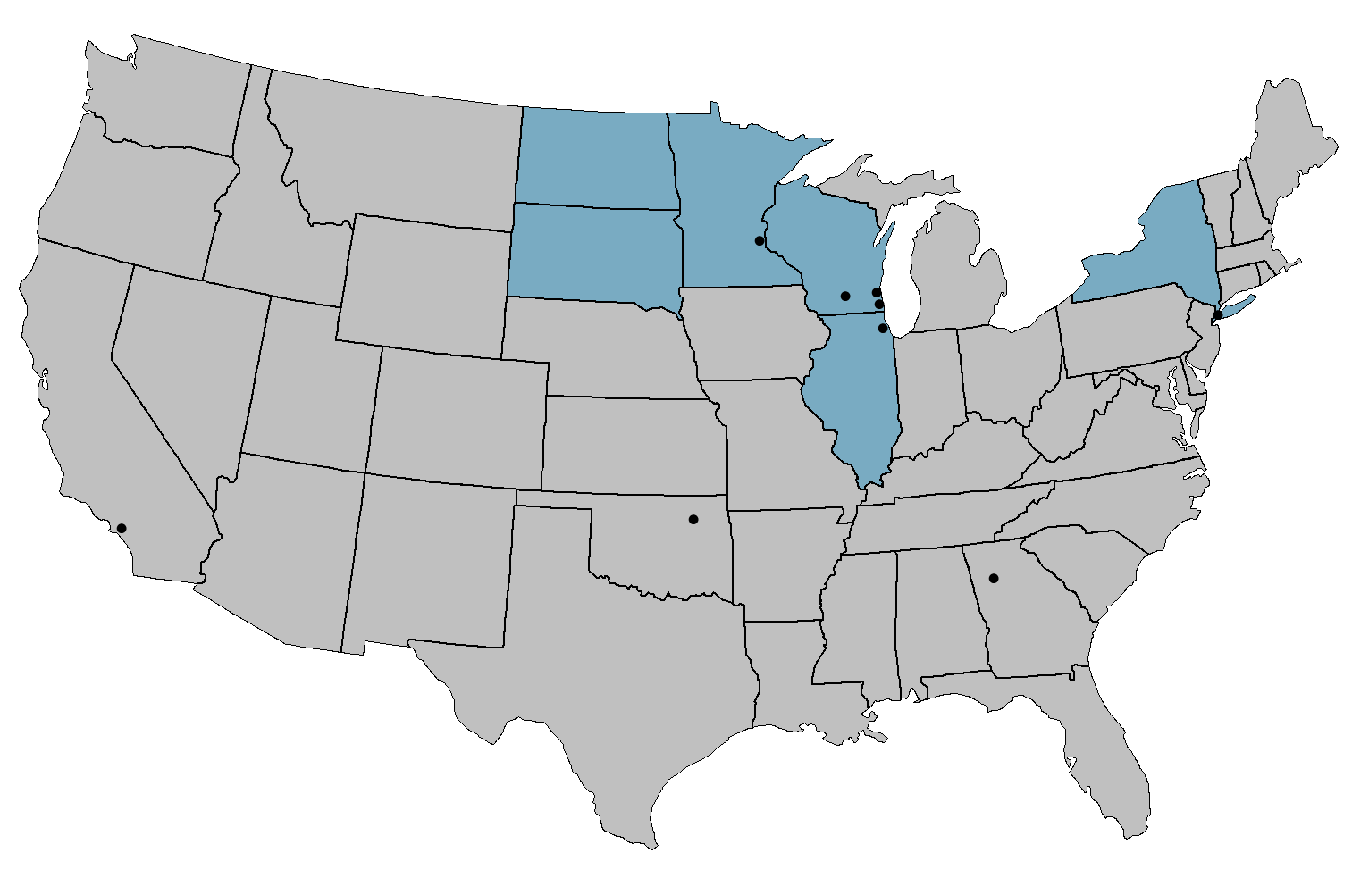
Districts and States Working with VARC
NORTH DAKOTA
MINNESOTA
Minneapolis
WISCONSIN
SOUTH DAKOTA
Milwaukee
Madison
NEW YORK
Racine
Chicago
New York City
ILLINOIS
Tulsa
Los Angeles
Atlanta
Hillsborough County
Collier County

Slide 4
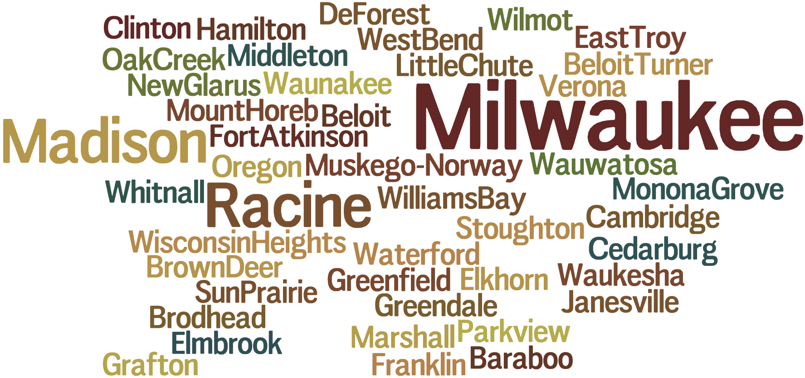
Value-Added in Wisconsin
Notes:
44 Districts in Wisconsin

Slide 5
Achievement and Value-Added
For the most complete picture of student and school performance, it is best to look at both Achievement and Value-Added.
This will tell you:
  What students know at a point in time (Achievement)
  How your school is affecting student academic growth (Value-Added)

Slide 6
The Power of Two
&
Achievement
Value-Added
Compares students’ performance to a standard
Measures students’ individual academic growth longitudinally
A more complete picture of student learning
Does not factor in students’ background characteristics
Factors in students’ background characteristics outside of the school’s control
Measures students’ performance at a single point in time
Measures the impact of teachers and schools on academic growth
Critical to students’ post-secondary opportunities
Critical to ensuring students’ future academic success
Adapted from materials created by Battelle for Kids

Slide 7
Value-Added Model Description
Objective
Output
Productivity estimates for contribution of educational units (schools, classrooms, teachers) to student achievement growth
Controls for non-school factors
(prior achievement, student and family characteristics)
Quasi-experimental statistical model
Valid and fair comparisons of school productivity, given that schools may serve very different student populations
Design
Notes:
A value-added model (VAM) is a quasi-experimental statistical model that yields estimates of the contribution of schools, classrooms, teachers, or other educational units to student achievement, controlling for non-school sources of student achievement growth, including prior student achievement and student and family characteristics.
A VAM produces estimates of productivity under the counterfactual assumption that all schools serve the same group of students. This facilitates apples-to-apples school comparisons rather than apples-to-oranges comparisons.
The objective is to facilitate valid and fair comparisons of productivity with respect to student outcomes, given that schools may serve very different student populations.

Slide 8
Value-added basics – The Oak tree analogy

Slide 9

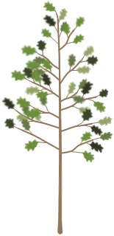

The Oak Tree Analogy
Notes:
This Oak Tree Analogy was created to introduce the concept of value added calculations. It is not in the education context in an attempt to keep this overview of the theory of value added separate from details specific to its use in education.

Slide 10


Explaining Value-Added by Evaluating Gardener Performance
For the past year, these gardeners have been tending to their oak trees trying to maximize the height of the trees.
Gardener A
Gardener B
Notes:
In this analogy, we will be explaining the concept of value added by evaluating the performance of two gardeners.
For the past year, these gardeners have been tending to their oak trees trying to maximize the height of the trees. Each gardener used a variety of strategies to help their own tree grow. We want to evaluate which of these two gardeners was more successful with their strategies.

Slide 11
Method 1: Measure the Height of the Trees Today (One Year After the Gardeners Began)
Using this method, Gardener B is the more effective gardener.
This method is analogous to using an Achievement Model.
Gardener A
72 in.
Gardener B
61 in.
Notes:
To measure the performance of the gardeners, we will measure the height of the trees today, 1 year after they began tending to the trees.
With a height of 61 inches for Oak Tree A and 72 inches for Oak Tree B, we find Gardener B to be the better gardener.
This method is analogous to using an achievement Model to evaluate performance.

Slide 12
Pause and Reflect
How is this similar to how schools have been judged in Wisconsin?
What information is missing from our gardener evaluation?

Slide 13


This Achievement Result is not the Whole Story
We need to find the starting height for each tree in order to more fairly evaluate each gardener’s performance during the past year.
Gardener A
72 in.
Gardener B
61 in.
52 in.
47 in.
Oak A
Age 3
(1 year ago)
Oak A
Age 4
(Today)
Oak B
Age 3
(1 year ago)
Oak B
Age 4
(Today)
Notes:
…but this achievement result does not tell the whole story.
These gardeners did not start with acorns. The trees are 4 years old at this point in time.
We need to find the starting height for each tree in order to more fairly evaluate each gardener’s performance during the past year.
Looking back at our yearly record, we can see that the trees were much shorter last year.

Slide 14
Method 2: Compare Starting Height to Ending Height
Oak B had more growth this year, so Gardener B is the more effective gardener.
This is analogous to a Simple Growth Model, also called Gain.
Gardener A
+20 in.
72 in.
Gardener B
+14 in.
61 in.
52 in.
47 in.
Oak A
Age 3
(1 year ago)
Oak A
Age 4
(Today)
Oak B
Age 3
(1 year ago)
Oak B
Age 4
(Today)
Notes:
We can compare the height of the trees one year ago to the height today.
By finding the difference between these heights, we can determine how many inches the trees grew during the year of gardener’s care.
By using this method, Gardener A’s tree grew 14 inches while Gardener B’s tree grew 20 inches. Oak B had more growth this year, so Gardener B is the better gardener.
This is analogous to using a Simple Growth Model, also called Gain.

Slide 15
What About Factors Outside the Gardener’s Influence?
This is an “apples to oranges” comparison.
For our oak tree example, three environmental factors we will examine are:
Rainfall, Soil Richness, and Temperature.
Gardener A
Gardener B
Notes:
But this Simple Growth result does not tell the whole story either.
Although we know how many inches the trees grew during this year, we do not yet know how much of this growth was due to the strategies used by the gardeners themselves.
This is an “apples to oranges” comparison.
If we really want to fairly evaluate the gardeners, we need to take into account other factors that influenced the growth of the trees.
For our oak tree example, three environmental factors we will examine are: Rainfall, Soil Richness, and Temperature.

Slide 16

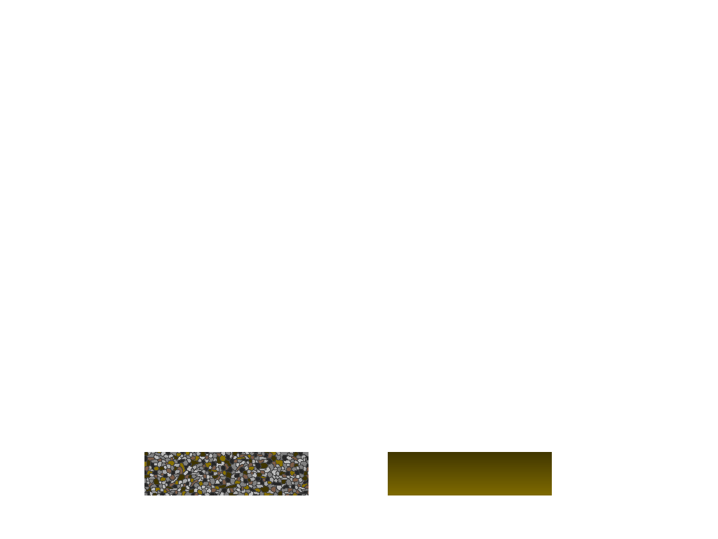
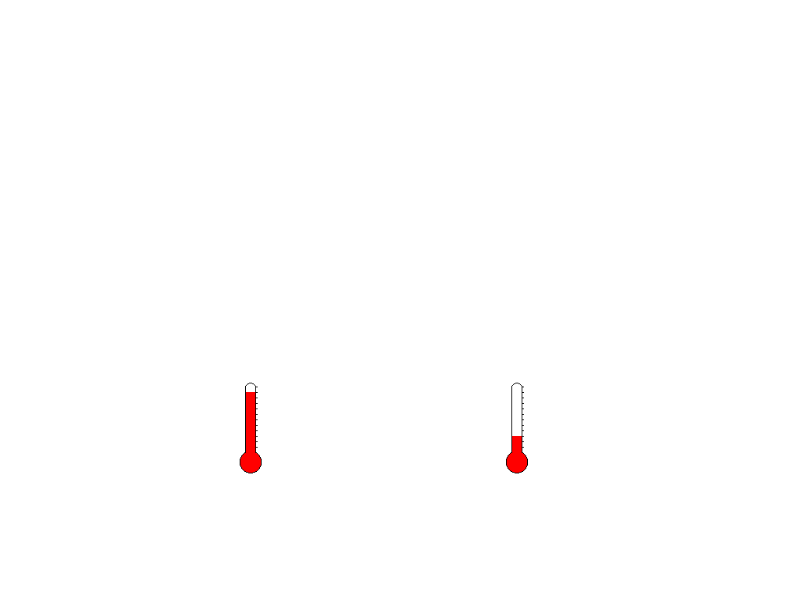
External condition | Oak Tree A | Oak Tree B
Rainfall amount
Soil richness
Temperature
High Low
Low High
High Low
Gardener A
Gardener B
Notes:
Based on the data for our trees, we can see what kind of external conditions our two trees experienced during the last year.
Oak Tree A was in a region with High rainfall while Oak Tree B experienced Low rainfall.
Oak Tree A had low soil richness while Oak Tree B has high soil richness.
Oak Tree A had high temperature while Oak Tree B had low temperature.

Slide 17
How Much Did These External Factors Affect Growth?
We need to analyze real data from the region to predict growth for these trees.
We compare the actual height of the trees to their predicted heights to determine if the gardener’s effect was above or below average.
Gardener A
Gardener B
Notes:
We can use this information to calculate a predicted height for each tree today if it was being cared for by an average gardener in the area.
We examine all oaks in the region to find an average height improvement for trees.
We adjust this prediction for the effect of each tree’s environmental conditions.
We compare the actual height of the trees to their predicted heights to determine if the gardener’s effect was above or below average.

Slide 18
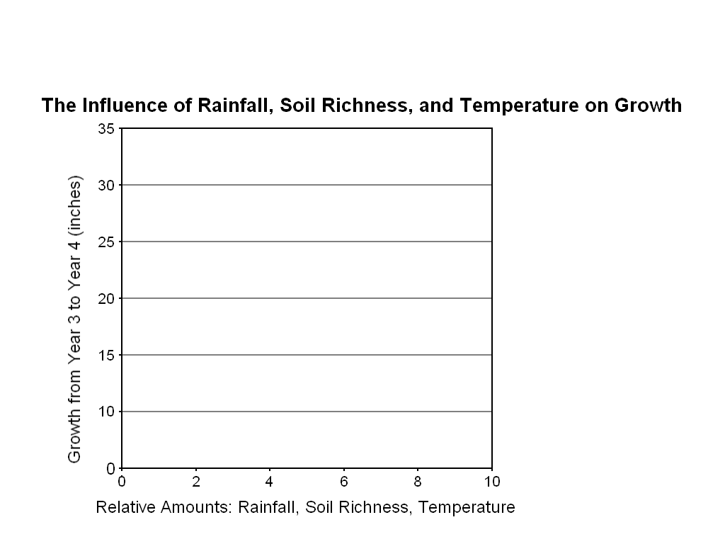
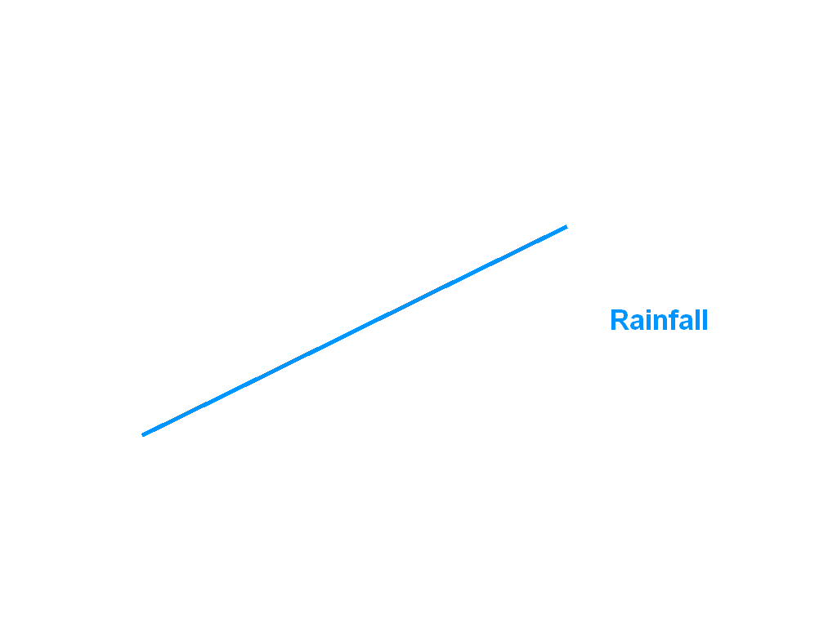
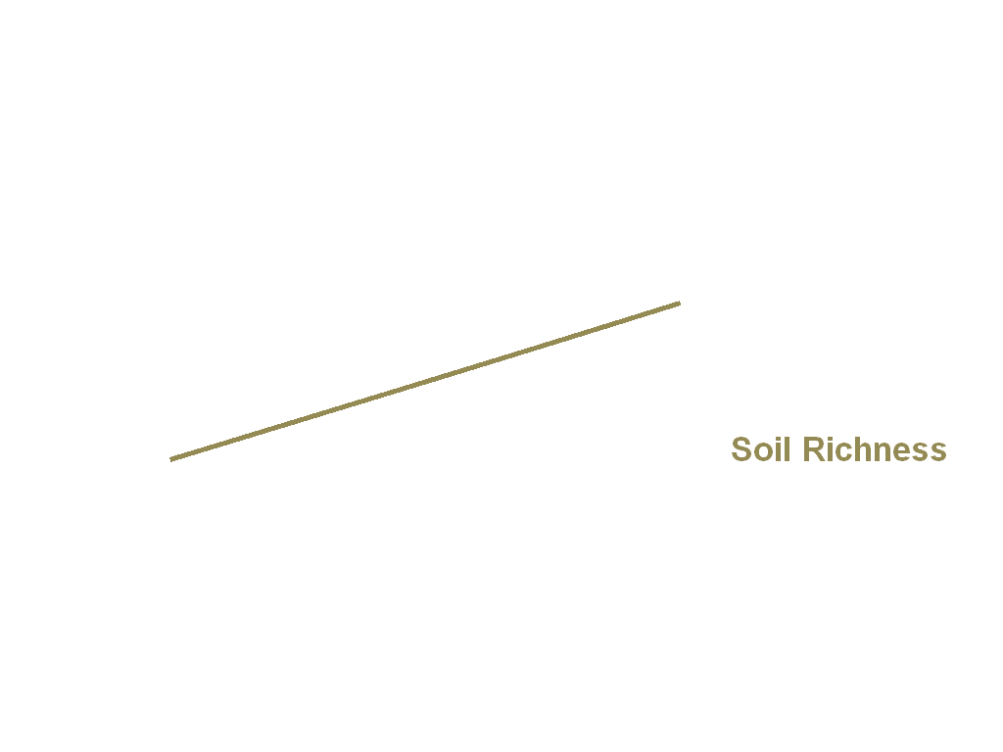
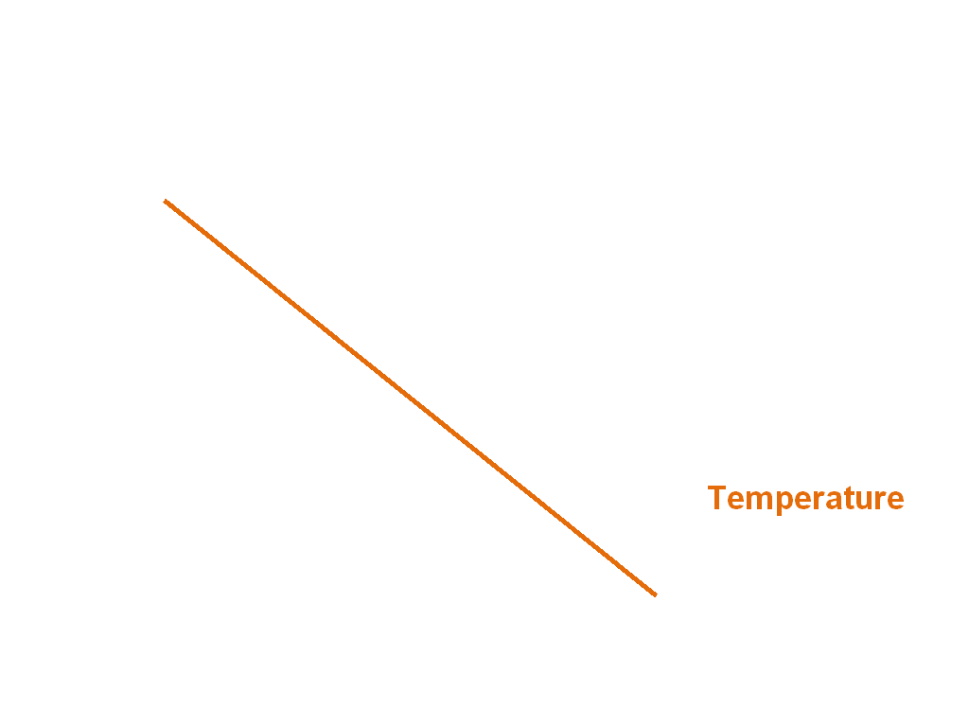
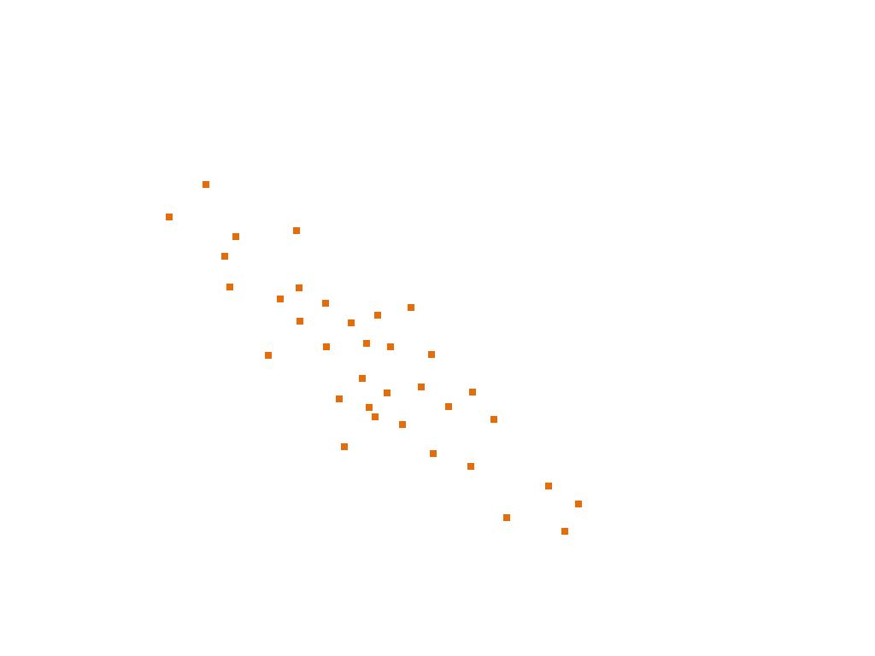
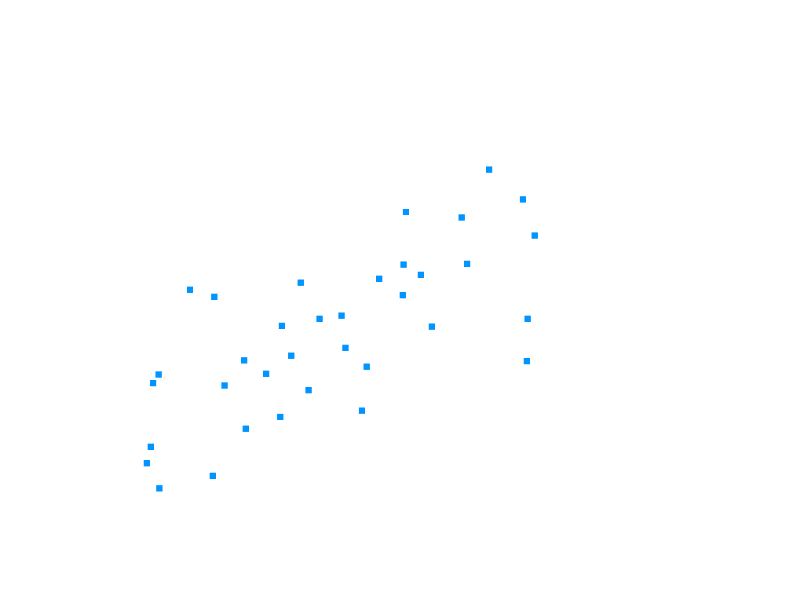

In order to find the impact of rainfall, soil richness, and temperature, we will plot the growth of each individual oak in the region compared to its environmental conditions.
Notes:
In order to find the impact of rainfall, soil richness, and temperature, we will plot the growth of each individual oak in the region compared to its environmental conditions.
On the x-axis, we plot the relative amount of each environmental condition. On the y-axis, we plot how much each tree grew from year 3 to year 4.
Each dot represents a single oak tree in the area. By calculating an average line through the data, we can determine a trend for each environmental factor.
From the data we collected for our region, we find that more rainfall and higher soil richness contributed positively to growth. Higher temperatures contributed negatively to growth.

Slide 19
Calculating Our Prediction Adjustments Based on Real Data
Rainfall | Low | Medium | High
Growth in inches relative to the average | -5 | -2 | +3
Soil Richness | Low | Medium | High
Growth in inches relative to the average | -3 | -1 | +2
Temperature | Low | Medium | High
Growth in inches relative to the average | +5 | -3 | -8
Notes:
Now that we have identified growth trends for each of these environmental factors, we need to convert them into a form usable for our predictions.
We can summarize our trend information by determining a numerical adjustment based on High, Medium, and Low amount of each environmental condition.
For example, based on our data, we found that oak trees that experienced low rainfall tended to have 5 fewer inches of growth compared to the average growth of oak trees in the region.
Trees with medium rainfall tended to have 2 fewer inches of growth compared to the average. Trees with high rainfall tended to have 3 more inches of growth compared to the average.
We calculate these numerical adjustments for all environmental conditions to summarize the trends from the data.
Now we can go back to Oak A and Oak B to adjust for their growing conditions.

Slide 20
Make Initial Prediction for the Trees Based on Starting Height
Next, we will refine out prediction based on the growing conditions for each tree. When we are done, we will have an “apples to apples” comparison of the gardeners’ effect.
Gardener A
72 in.
Gardener B
67 in.
52 in.
47 in.
+20 Average
+20 Average
Oak A
Age 3
(1 year ago)
Oak A
Prediction
Oak B
Age 3
(1 year ago)
Oak B
Prediction
Notes:
To make our initial prediction, we use the average height improvement for all trees.
Based on our data, the average improvement for oak trees in the region was 20 inches during the past year.
We start with the trees’ height at age 3 and add 20 inches for our initial prediction.
Next, we will refine our prediction based on the growing conditions for each tree. When we are done, we will have an “apples to apples” comparison of the gardeners’ effect.

Slide 21
Based on Real Data, Customize Predictions based on Rainfall
For having high rainfall, Oak A’s prediction is adjusted by +3 to compensate.
Similarly, for having low rainfall, Oak B’s prediction is adjusted by -5 to compensate.
Gardener A
70 in.
67 in.
Gardener B
52 in.
47 in.
+20 Average
+20 Average
+ 3 for Rainfall
- 5 for Rainfall
Notes:
Based on data for all oak trees in the region, we found that high rainfall resulted in 3 inches of extra growth on average.
For having high rainfall, Oak A’s prediction is adjusted by +3 to compensate.
Similarly, for having low rainfall, Oak B’s prediction is adjusted by -5 to compensate.

Slide 22
Adjusting for Soil Richness
For having poor soil, Oak A’s prediction is adjusted by -3.
For having rich soil, Oak B’s prediction is adjusted by +2.
Gardener A
69 in.
Gardener B
67 in.
52 in.
47 in.
+20 Average
+20 Average
+ 3 for Rainfall
- 5 for Rainfall
- 3 for Soil
+ 2 for Soil
Notes:
We continue this process for our other environmental factors.
For having poor soil, Oak A’s prediction is adjusted by -3.
For having rich soil, Oak B’s prediction is adjusted by +2.

Slide 23
Adjusting for Temperature
For having high temperature, Oak A’s prediction is adjusted by -8.
For having low temperature, Oak B’s prediction is adjusted by +5.
74 in.
Gardener A
Gardener B
59 in.
52 in.
47 in.
+20 Average
+20 Average
+ 3 for Rainfall
- 5 for Rainfall
- 3 for Soil
+ 2 for Soil
- 8 for Temp
+ 5 for Temp
Notes:
For having high temperature, Oak A’s prediction is adjusted by -8.
For having low temperature, Oak B’s prediction is adjusted by +5.

Slide 24
Our Gardeners are Now on a Level Playing Field
The predicted height for trees in Oak A’s conditions is 59 inches.
The predicted height for trees in Oak B’s conditions is 74 inches.
74 in.
Gardener A
Gardener B
59 in.
52 in.
47 in.
+20 Average
+20 Average
+ 3 for Rainfall
- 5 for Rainfall
- 3 for Soil
+ 2 for Soil
- 8 for Temp
+ 5 for Temp
_________
+12 inches
During the year
_________
+22 inches
During the year
Notes:
Now that we have refined our predictions based on the effect of environmental conditions, our gardeners are on a level playing field.
The predicted height for trees in Oak A’s conditions is 59 inches.
The predicted height for trees in Oak B’s conditions is 74 inches.

Slide 25
Compare the Predicted Height to the Actual Height
Oak A’s actual height is 2 inches more than predicted. We attribute this to the effect of Gardener A.
Oak B’s actual height is 2 inches less than predicted. We attribute this to the effect of Gardener B.
-2
74 in.
72 in.
Gardener A
+2
Gardener B
61 in.
59 in.
Predicted
Oak A
Actual
Oak A
Predicted
Oak B
Actual
Oak B
Notes:
Finally, we compare the actual height of the trees to our predictions.
Oak A’s actual height of 61 inches is 2 inches more than we predicted. We attribute this above-average result to the effect of Gardener A.
Oak B’s actual height of 72 inches is 2 inches less than we predicted. We attribute this below-average result to the effect of Gardener B.

Slide 26
Method 3: Compare the Predicted Height to the Actual Height
By accounting for last year’s height and environmental conditions of the trees during this year, we found the “value” each gardener “added” to the growth of the trees.
This is analogous to a Value-Added measure.
-2
74 in.
72 in.
Gardener A
+2
Gardener B
61 in.
59 in.
Above
Average
Value-Added
Below
Average
Value-Added
Predicted
Oak A
Actual
Oak A
Predicted
Oak B
Actual
Oak B
Notes:
Using this method, Gardener A is the superior gardener.
By accounting for last year’s height and environmental conditions of the trees during this year, we have found the “value” each gardener “added” to the growth of the tree.
This is analogous to a value added measure.

Slide 27
How does this analogy relate to value added in the education context?
 | Oak Tree Analogy | Value-Added in Education
What are we evaluating? | Gardeners | Districts Schools Grades Classrooms Programs and Interventions
What are we using to measure success? | Relative height improvement in inches | Relative improvement on standardized test scores
Sample | Single oak tree | Groups of students
Control factors | Tree’s prior height Other factors beyond the gardener’s control: Rainfall Soil richness Temperature | Students’ prior test performance (usually most significant predictor) Other demographic characteristics such as: Grade level Gender Race / Ethnicity Low-Income Status ELL Status Disability Status Section 504 Status
Notes:
This analogy was purposefully kept out of the education context. How does this analogy relate to value added estimates in the education context?
What are we evaluating? In the oak tree analogy, we evaluated gardeners. In the education context, we are evaluating districts, schools, grades, classrooms, programs, and interventions.
What are we using to measure success? In the oak tree analogy, we measure relative height improvement in inches. In the education context, we measure relative improvement on standardized test scores.
What about our sample? In the oak tree analogy, we only used a single oak tree per gardener. In the education context, we use groups of students.
What do we control for? In the oak tree analogy, we accounted for the tree’s prior height and analyzed data for rainfall, soil richness, and temperature. We were then able to incorporate their influence in our prediction. We call this “controlling” for these factors. In the education context, we control for prior performance. This tends to be the most significant predictor of student performance. Based on what other data is available, we also control for other factors beyond the district, school, or classroom’s influence, such as:

Slide 28
Another Visual Representation
The Education Context
Actual student achievement
scale score
Value-Added
Starting student achievement scale score
Predicted student achievement
(Based on observationally
similar students)
Year 1
(Prior-test)
Year 2
(Post-test)

Slide 29
Education based examples
Attainment to Gain to Growth to Value-Added
Ernest Morgan

Slide 30
Attainment and Gain
Attainment – a “point in time” measure of student proficiency
  compares the measured proficiency rate with a predefined proficiency goal.
Gain – measures average gain in student scores from one year to the next

Slide 31
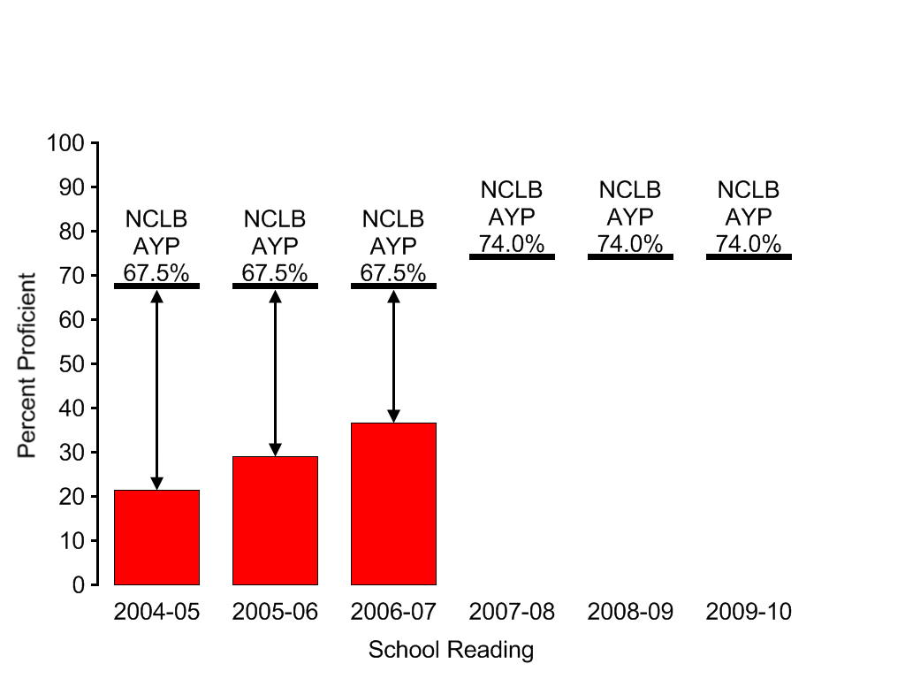



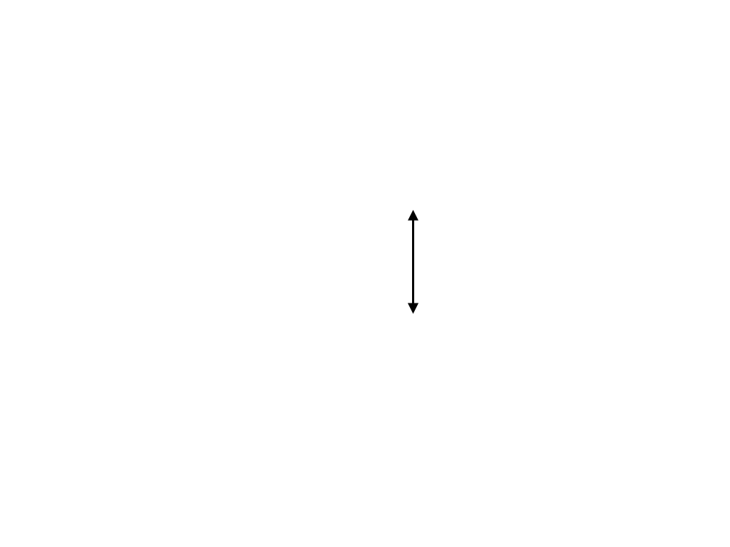
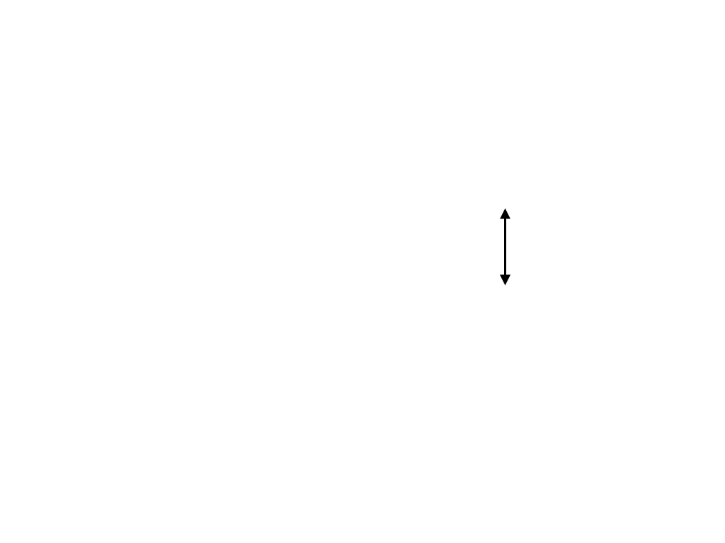
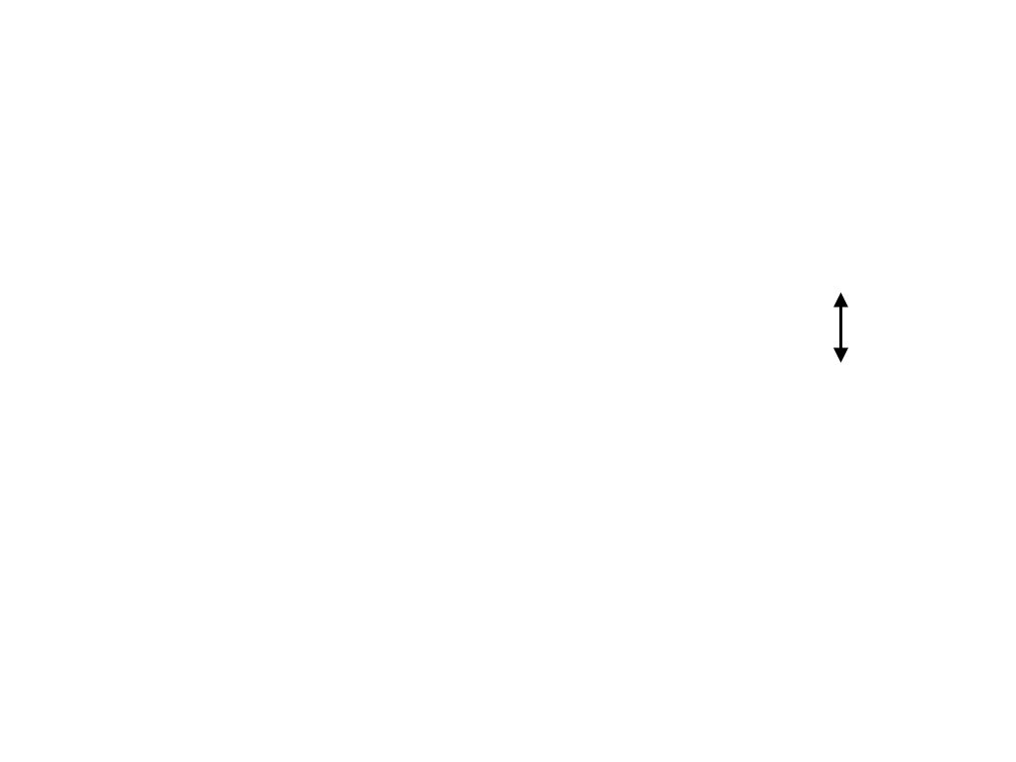

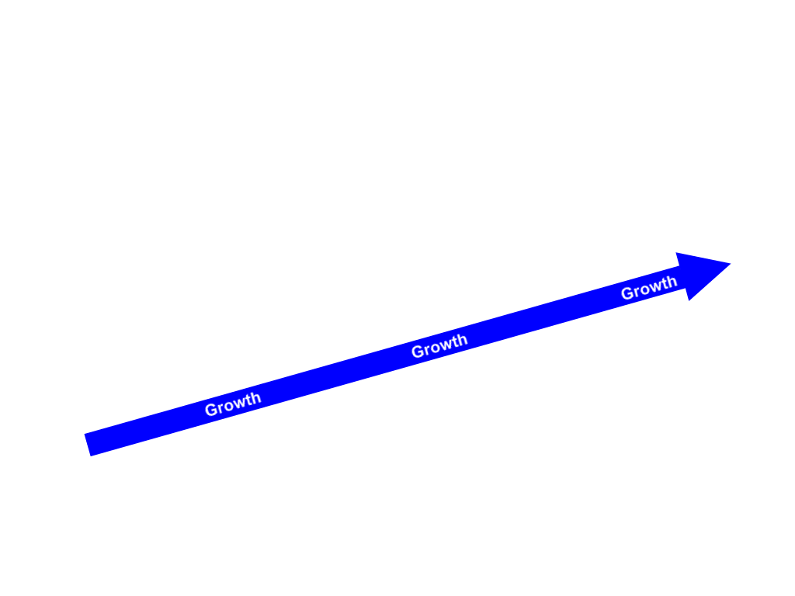
Attainment versus Gain
Gain
Gain
Gain
Grade 3
Grade 4
Grade 5
Grade 6
Grade 7
Grade 8

Slide 32



Slide 33
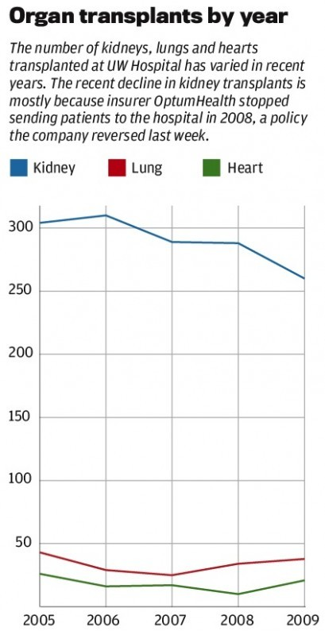
Kidney transplant success rate
(January 2005 to June 2007)
UW-Health | Expected Rate | National Average
89.78 | 92.30 | 92.56
Response to this loss of accreditation
UW Hospital transplant doctors have said they are more aggressive than other centers in transplanting patients quickly, which can save more lives but lead to lower success rates.
They have also said the hospital's organ donors are older and have more complications than elsewhere, but the formula to determine expected rates doesn't fully take that into account.

Slide 34
Growth
Growth – measures average gain in student scores from one year to the next
  accounts for the prior knowledge of students.

Slide 35
Growth: Starting Point Matters
Reading results of a cohort of students at two schools
School | 2006 Grade 4 Scale Score Avg. | 2007 Grade 5 Scale Score Avg. | Average Scale Score Gain
A | 455 | 465 | 10
B | 425* | 455* | 30
Grade 4 Proficient Cutoff 438
Grade 5 Proficient Cutoff 463
*Scale Score Average is below Proficient
Example assumes beginning of year testing

Slide 36
Exercise #1:
Discussion Questions
Using only the 2006 Scale Score data, can we draw any conclusions about the performance of the two school cohorts in Grade 4?
Using only the 2007 Scale Score data, can we draw any conclusions about the performance of the two school cohorts in Grade 5?
What does an examination of basic growth -Average Scale Score - Grade 4 (2006) to Average Scale Score - Grade 5 (2007) – tell us about the performance of the two schools?
Notes:
Reference Notes:
Small then large group discussions

Slide 37
WKCE Pre-Test and Post-Test
Grade 3
Summer
Grade 4
Summer
Grade 5
Summer
Grade 6
Nov
Nov
Nov
Nov
3rd Grade
Value-Added
4th Grade
Value-Added
5th Grade
Value-Added
Why don’t we have 8th Grade Value-Added in Wisconsin?

Slide 38
Value-Added
Value-Added – measures average gain in student scores from one year to the next
  accounts for the prior knowledge of students.
  accounts for student demographic characteristics.
  accounts for test measurement error.

Slide 39
What is Value-Added?
It is a kind of growth model that measures the contribution of schooling to student performance on the WKCE in reading and in mathematics
Uses statistical techniques to separate the impact of schooling from other factors that may influence growth
Focuses on how much students improve on the WKCE from one year to the next as measured in scale score points
Notes:
Value-added is a growth metric that tries to isolate the contribution of a school or grade to student performance.
Holding a number of factors constant (e.g., Free/Reduced Lunch Status, ELL, Prior Achievement, Gender, Race), what impact did a school or grade have on student learning?
For the first time, using value-added we can compare schools on the same playing field that we would not have been able to compare before. For example, a high-poverty school to a lower poverty school. An urban to a rural, for example.

Slide 40
Demographic Controls
Value-added controls for the demographic composition of schools
These controls allow for fairer growth comparisons to be made
Controlling for demographic factors make possible the measurement of differences in growth across demographic groups statewide (for example, ELL vs non-ELL)
Notes:
Controlling for Demographic factors allows us to compare “apples to apples” instead of “apples to oranges.” By isolating the schools impact apart from demographic makeup of its student population, it is possible to accurately compare schools that would appear to be very different.
Examples of things that are controlled for in a value-added model include:
Free/Reduced Lunch Status
ELL
Prior Achievement
Gender
Race
Disability

Slide 41
The Importance of Standard Measures
Gas Station 1
Gas Station 2
87 Octane $2.00/Gallon
87 Octane $3.00/Gallon
With the information provided, from which station will you purchase gas?
In making your decision, what are you assuming about the definition of a gallon?

Slide 42
Value-Added Reporting
PDF Report
Value-Added Scale
Color Coding
Sean McLaughlin

Slide 43

Value-Added Reports
Report based on growth during the 2010-2011 school year
Value-Added on 1-5 “tier” scale
New color report format

Slide 44
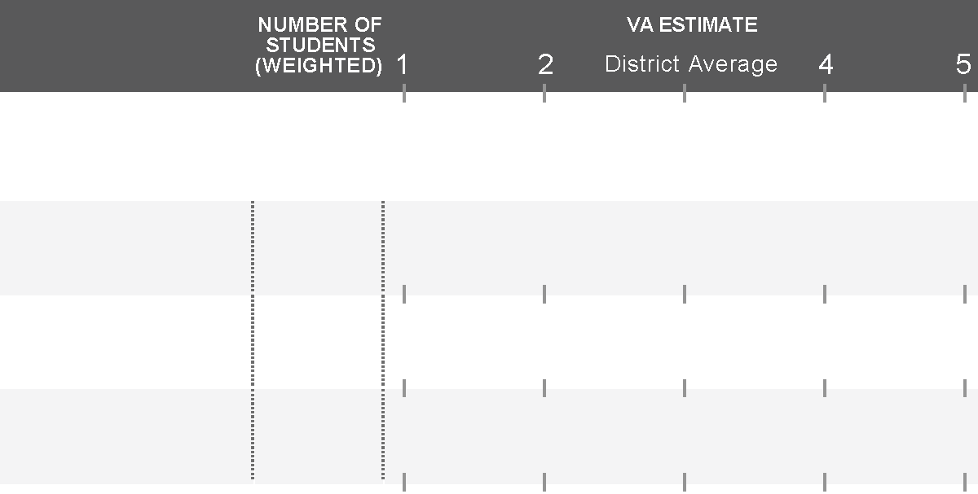
Confidence Intervals and
Decision Making
3
MATH
Grade 4
30
1.3
Grade 5
30
2.5
Overall
60
1.9

Slide 45
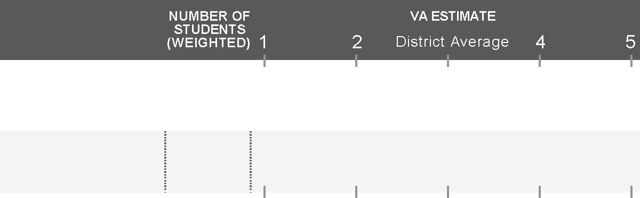
Confidence Intervals and
Decision Making
3
READING
Grade 4
30
3.0
95% Confidence Interval
Value-Added estimates are provided with a confidence interval.
Based on the data available for these thirty 4th Grade Reading students, we are 95% confident that the true Value-Added lies between the endpoints of this confidence interval (between 2.4 and 3.6 in this example), with the most likely estimate being 3.0.

Slide 46
Value-Added Color Coding
3
READING
Grade 4
30
3.0
Grade 5
30
2.5
Grade 6
15
4.1
If the confidence interval crosses 3, the color is gray.

Slide 47
Value-Added Color Coding
3
READING
Grade 4
30
3.7
Grade 5
30
4.1
Grade 6
15
4.4
If the entire confidence interval is above 3, the color is green.

Slide 48
Value-Added Color Coding
3
READING
Grade 4
30
4.6
Grade 5
30
5.1
Grade 6
15
5.3
If the entire confidence interval is above 4, the color is blue.

Slide 49
Value-Added Color Coding
3
READING
Grade 4
30
2.3
Grade 5
30
1.8
Grade 6
15
1.3
If the entire confidence interval is below 3, the color is yellow.

Slide 50
Value-Added Color Coding
3
READING
Grade 4
30
1.3
Grade 5
30
0.8
Grade 6
15
0.3
If the entire confidence interval is below 3, the color is red.

Slide 51
Value-Added Color Coding
These colors are meant to categorize results at a glance, but making responsible decisions based on Value-Added estimates may require more careful use of the data.
General guidelines:
Green and Blue results are areas of relative strength. Student growth is above average.
Gray results are on track. In these areas, there was not enough data available to differentiate this result from average.
Yellow and Red results are areas of relative weakness. Student growth is below average.

Slide 52

How to Read the Scatter Plots
100
These scatter plots are a way to represent Achievement and Value-Added together
Achievement
80
60
Percent Prof/Adv (2009)
Value-Added
40
20
0
1
2
3
4
5
Value-Added (2009-2010)

Slide 53
How to Read the Scatter Plots
A. Students know a lot and are growing faster than predicted
100
C
A
B. Students are behind, but are growing faster than predicted
80
E
C. Students know a lot, but are growing slower than predicted
60
Percent Prof/Adv (2009)
B
D. Students are behind, and are growing slower than predicted
40
D
E. Students are about average in how much they know and how fast they are growing
20
0
1
2
3
4
5
Schools in your district
Value-Added (2009-2010)

Slide 54
Educator Effectiveness
Brad Carl

Slide 55
DPI Educator Effectiveness
Phase I: Design Team report November 2011
  Year-long process of engagement among stakeholder organizations to develop vision for new system of teacher & principal evaluation in WI

Slide 56
DPI Educator Effectiveness
Phase II: Four work groups convened to develop more detailed process to match principles outlined in Phase I:
  Teacher Practice
  Principal Practice
  Student Learning Objectives
  Data Systems/Data Quality
    A related, cross-cutting area of work will involve further development of district assessment data and combining these measures into formative and summative ratings

Slide 57
Educator Effectiveness Timeline *
Stage 1
Developing
Stage 2
Piloting
Stage 3
Implementing
Framework released
Model development
Developmental districts
Voluntary Pilots
Development work
Evaluator and educator training
System training
Pilot evaluation
Model revisions
Training continued
Statewide implementation strategy
Educator effectiveness system implemented statewide
2011-12
2012-13
2013-14
2014-15
Continuous Improvement
*All work contingent on funding and resources

Slide 58
System Weights
50%
Student Growth
50%
Educator Practice

Slide 59
Models of Practice Detail (50% of evaluation)
50%
Student Growth
50%
Educator Practice
Teacher
  InTASC
  (Danielson or equivalency review)
Principal
  ISLLC

Slide 60
Student Outcome Detail (50% of evaluation)
Models of Practice
Student Learning Objectives
District Choice

Slide 61
Student Outcome Weights (PK-8)
State assessment, district assessment, SLOs, and other measures
SLOs and other measures
Notes:
SLOs only (neither state nor districtwide assessments, for example -a music teacher):
PK–8: 90% SLOs, 5% schoolwide reading and 5% district choice
9–12: 90% SLOs, 5% graduation rate, and 5% district choice

Slide 62
Student Outcome Weights (9-12)
State assessment, district assessment, SLOs, and other measures
SLOs
Notes:
PK–8: 90% SLOs, 5% schoolwide reading and 5% district choice
9–12: 90% SLOs, 5% graduation rate, and 5% district choice

Slide 63
Educator Effectiveness System Matrix
 | Student Outcomes
Models of Practice |  | 1 | 2 | 3 | 4 | 5
 | 1 |  |  |  | * | *
 | 2 |  |  |  |  | *
 | 3
 | 4 | *
 | 5 | * | *
Asterisks indicate a mismatch between educator’s practice performance and student outcomes and requires
a focused review to determine why the mismatch is occurring and what, if anything, needs to be corrected.

